Slide 1
Making this resource work for you
Prior to teaching this lesson, please refer to the ‘Unit Overview and Planning Document’.
Further guidance on planning Science Mastery lessons can be found in the detailed planning guidance document.
Refer to the ‘notes’ section on each slide for useful information, including suggested expositions, pedagogical content knowledge, suggested questions, answers and more. Consider using presenter mode so you can see this guidance throughout the lesson.
The introduction slides can be adapted to suit your teaching style and the needs of your class.
Before the lesson, adapt the fix-it slide to address any misconceptions identified in the previous lesson’s exit ticket.
Choose from the suggested activities to suit your class. The intention is not that you complete all of these, but that you select those which ones are most appropriate for your students. It may be appropriate to further adapt activities for your students.
These lessons are designed to occupy approximately 1 hour. To adapt for a shorter or longer lesson duration we advise you to adapt the activity section accordingly.
Please consider using the final slide to send feedback about this lesson or examples of PowerPoints that you have adapted to our design team. Your feedback is used to improve Science Mastery for all of our teachers and students. We appreciate all suggestions and comments.
Thank you for reading!
The Science Mastery Team

Slide 2
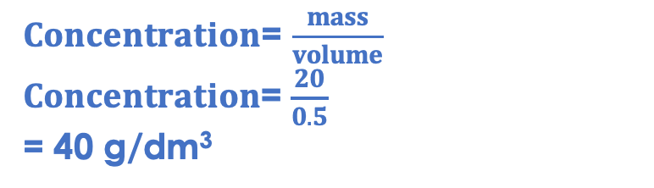
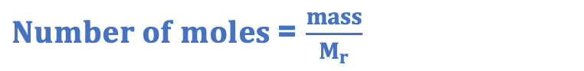
Taking it Further: Calculating Concentration
Answer the questions below.
Define concentration.
State a unit used to measure concentration.
Calculate the concentration of 500 cm3 of solution that has 20 g of solute dissolved in it.
State Avogadro’s number.
State the equation that links number of moles, mass and relative formula mass.
The mass of solute in a given volume of solution.
g/dm³
$Concentration$= $\frac{mass}{volume}$
$Concentration$= $\frac{20}{0.5}$
= 40 g/dm³
6.02 x10²³
$Number of moles$= $\frac{mass}{M_{r}}$
Notes:
Big idea: Reactions rearrange matter
Foundation: Calculate the relative formula mass of ammonia (NH₃).
Stretch: Calculate the number of moles in 120 g of ammonia.
Answers:
Foundation: 14+(3x1) = 17
Stretch: 120/17 = 7.06 moles

Slide 3
Taking it Further: Calculating Concentration
Do Now:
Define concentration.
State a unit used to measure concentration.
Calculate the concentration of 500 cm3 of solution that has 20 g of solute dissolved in it.
State Avogadro’s number.
State the equation that links number of moles, mass and relative formula mass.
Drill:
State the unit for amount of substance.
Calculate the mass of 1 mole of carbon.
Calculate the number of moles in 48 g of carbon.
Notes:
Drill answers:
mol
n = m/Mr, so m = nxMr, 1 x 12 = 12 g
n = m/Mr, so n = 48/12 = 4 mol

Slide 4
Taking it Further: Calculating Concentration
Read Now:
Concentration can be measured in terms of grams of solute per unit volume, or in moles per unit volume (usually mol/dm³). We know that concentration = mass/volume, and number of moles = mass/relative formula mass. We can always calculate relative formula mass using the relative atomic masses from the periodic table. This means that we can use these two equations together to work between concentration, volume, mass and number of moles. For example, we want to calculate the mass of sodium hydroxide dissolved in 500 cm³ of 12 mol/dm³ solution, so we can first calculate the amount of substance (number of moles) that would be present in this volume, then use the relative formula mass of sodium hydroxide to determine the mass of this number of moles.
State the equation that links concentration, mass and volume.
State the equation that links number of moles, mass and relative formula mass.
Describe how to calculate the relative formula mass of a compound.
State the two different units that can be used for concentration.

Slide 5
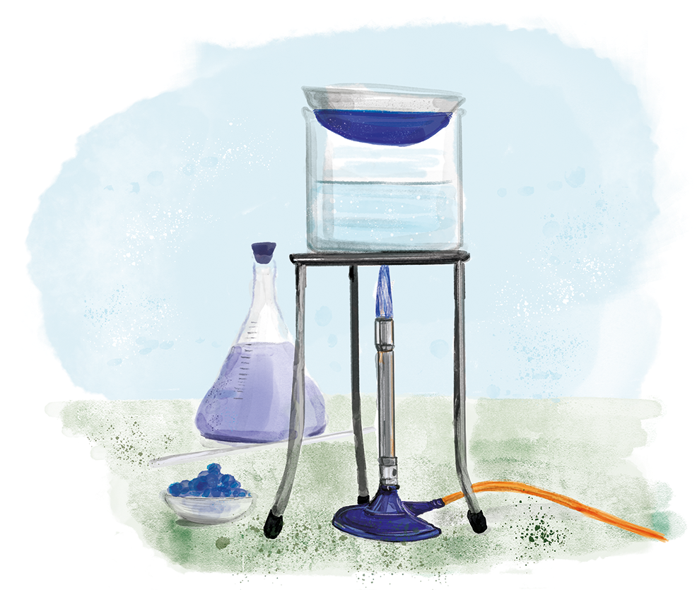
C4.3.5
15/11/2023
Taking it Further: Calculating Concentration
C4.3.1 Prior Knowledge Review
C4.3.2 (HT) Introducing the Mole
C4.3.3 (HT) Mole Calculations
C4.3.4 PKR: Concentration
C4.3.5 TIF: Calculating Concentration
C4.3.6 TIF: Calculating an Unknown Concentration
C4.3.7 (HT) Amounts of Substances in Equations
C4.3.8 (HT) Limiting Reactants
C4.3.9 PKR: Reactions of Acids
C4.3.10 Acids, Alkalis and Neutralisation
C4.3.11 TIF: Acid-Alkali Titration
C4.3.12 TIF: Acid-Alkali Titration Analysis
C4.3.13 TIF: Titration Calculations
C4.3.14 (HT) Strong and Weak Acids
C4.3.15 TIF: Volumes of Gases
Notes:
Big idea: Reactions rearrange matter
In this lesson, which is chemistry only, students will build on their knowledge of concentration and the relationship between mass, number of moles and Mr to work between the different equations.
Suggested Hook:
What does it mean if I have one mole of a compound dissolved in a given volume? How many particles would that be?

Slide 6

Following this lesson, students will be able to:
Calculate concentration in mol/dm³
Calculate the mass of solute from a concentration in mol/dm³
Explain how the concentration of a solution is related to the mass of solute and the volume of the solution
Key Words:
mass
volume
concentration
moles
solution
Notes:
Guidance:
See unit overview document and planning guidance to see how these objectives are typically assessed at GCSE, including examples of what students should be able to do following this lesson.
Planning for different needs:
The learning objectives given on this slide are suggested based on the most common requirements for exams, however they can be adapted based on the needs of different classes.
For best practice, the unit preparation booklet should be used to determine the appropriate focus of lessons within the unit.
While it is not possible to explicitly split content into levelled grades, we recommend that lesson objectives can be classified as critical, core or stretch.
Critical: the content or skill is essential for all students to be able to progress.
Core: the content or skill is important for students to progress, but other opportunities may be available to revisit it.
Stretch: the content or skill may not be essential for all students but is important for students aiming for the highest grades.
Key skill: this is a crucial skill being developed in this unit as part of the skill mapping
C4.3.5 Lesson Objectives:
Critical: Calculate concentration in mol/dm³
Critical: Calculate the mass of solute from a concentration in mol/dm³
Core: Explain how the concentration of a solution is related to the mass of solute and the volume of the solution

Slide 7
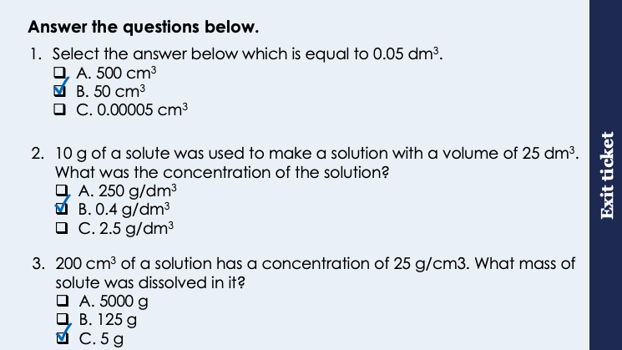
This is the fix-it portion of the lesson
The fix-it is an opportunity to respond to gaps in knowledge, especially those identified by the pre-unit quiz.
The teacher should customise this slide as needed, to facilitate
reteach, explanation, demonstration or modelling of ideas and concepts that students have not yet grasped or have misunderstood.
practise answering specific questions or of key skills.
redrafting or improving previous work.
Notes:
Purpose: to spend time on any gaps identified in previous learning from exit ticket.
Fix-it guidance from previous exit ticket:
Q1. Answer: B
If students answer A, it suggests they have multiplied by 10000 instead of 1000. To fix-it, give the student some more unit conversions to practise. Use slide 7 to reteach the method for converting from one unit to another.
If students answer C, it suggests they have divided by 1000 instead of multiplying by 1000 to convert dm³ to cm³. To fix it, reteach how to convert from one unit to another, using slide 7 to help. Give students some unit conversions to practice.
Q2. Answer: B
If students answer A, it suggests that they have multiplied the mass and volume instead of dividing. If students answer C, it suggests that they have divided volume by mass instead of the other way around. To fix it, remind the student of the correct formula to calculate concentration. Model the method to work this calculation out, and then give the student some similar calculations to try.
Q3. Answer: B
If students answer A, they have done the correct calculation but not converted the volume to dm³. If students answer B, they have converted the volume to dm³ but divided concentration by volume. To fix it, give students more calculation practice with conversions.

Slide 8

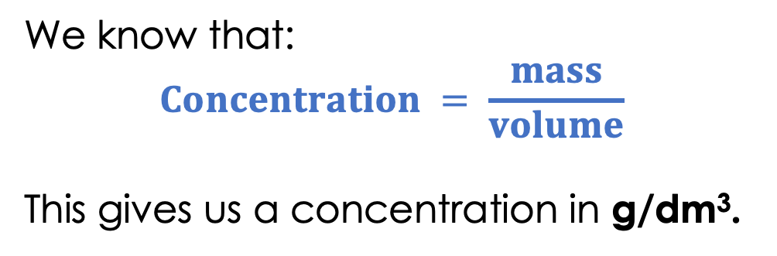
Concentration
We know that:
$$Concentration = \frac{mass}{volume}$$
This gives us a concentration in g/dm³.
Higher Tier only
When working with chemical reactions, it is much more useful for scientists to have a measure of the number of particles that are actually present.
We can also calculate concentration in moles per cubic decimetre (mol/dm³).
This tells us how many particles there are of a substance in a given volume of solution, rather than just the mass in grams.
Notes:
Suggested exposition:
From the last lesson, we know that concentration is the mass of solute in a given volume of solvent.
We know that concentration can be calculated using concentration = mass/volume, which gives us a concentration in g/dm3.
What does that actually mean about how much of a substance is in the solution? How many actual particles of solute are there in the solution?
We can use our knowledge of the relationship between number of moles, mass and relative formula mass to also work out the concentration of a solution in mol/dm3, which is the number of moles of solute dissolved in a given volume.
This allows scientists to use the number of particles of substance that are present, which can help them work out how many particles of different products will be made.

Slide 9
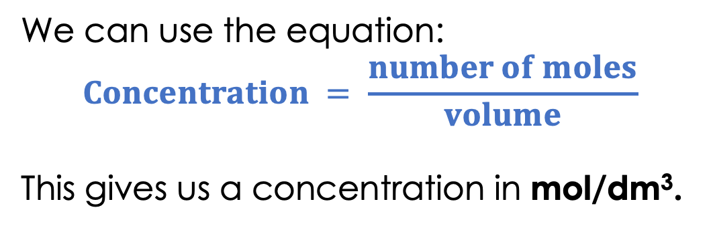
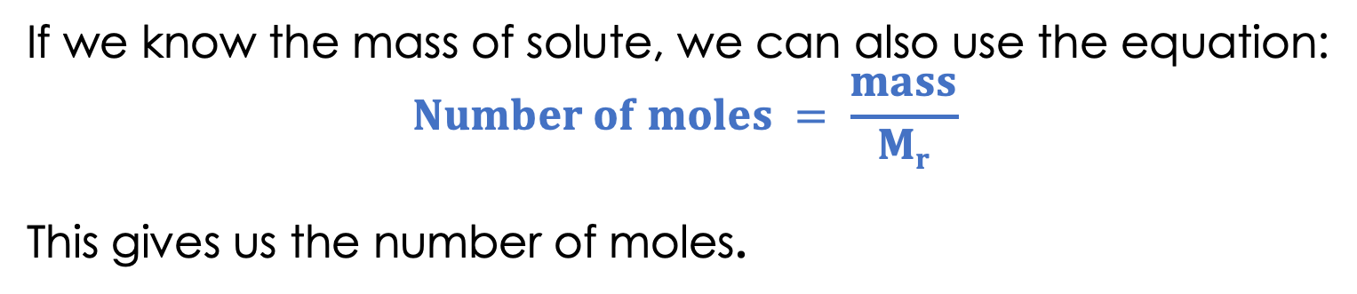
Mol/dm³
Higher Tier only
We can use the equation:
$$Concentration = \frac{number of moles}{volume}$$
This gives us a concentration in mol/dm³.
If we know the mass of solute, we can also use the equation:
$$Number of moles = \frac{mass}{Mr}$$
This gives us the number of moles.
Notes:
Suggested exposition:
When we calculate concentration, we have already calculated it as the mass of solute per unit volume. But we can also calculate it as the amount of solute per unit volume. Remember the amount of substance is the number of moles.
How many particles are there in one mole of any substance?
6.02 x 10²³
Sometimes we are given a mass of solute, or we ourselves add a certain mass of solute in grams to a solution. We can use another equation that we already know to work out how many moles there are in this mass of solute. Then we can use the calculation to determine concentration.
What is the equation that links number of moles, mass and Mr?
Number of moles = mass/Mr
Where do we get Mr from?
We can calculate it using the chemical formula and the relative atomic masses from the periodic table.

Slide 10

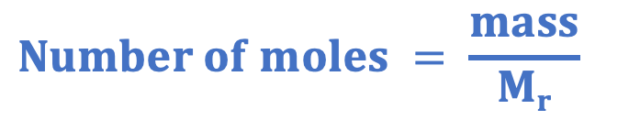


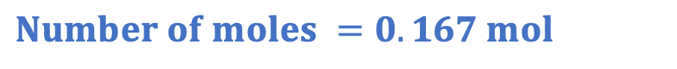
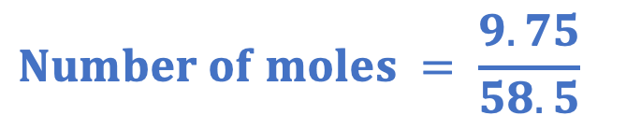
Worked Example
Higher Tier only
A scientist adds 9.75 g of sodium chloride to make 250 cm³ of salt solution.
What is the concentration of the solution in mol/dm³?
Mass = 9.75 g
$$Concentration= \frac{number of moles}{volume}$$
M_{r} (NaCl) = 23 + 35.5
= 58.5
$$Concentration= \frac{0.167}{0.25}$$
$$Number of moles = \frac{mass}{Mr}$$
$$Concentration=0.67 mol/dm 3$$
$$Number of moles = \frac{9.75}{58.5}$$
$$Number of moles =0.167 mol$$
Notes:
Suggested exposition:
Let’s look at a worked example. A scientist adds 50 g of sodium chloride to make 250 cm³ of salt solution. What is the concentration of the solution in mol/dm³?
If we were just calculating the concentration in g/dm³, we would simply use concentration = mass/volume.
But we’re not! We want to know exactly how much sodium chloride (in terms of particles, in this case ions) are in the solution.
What information do we have already?
Mass = 9.75 g.
What other information can we get from this question?
Volume - we’ll come back to that later.
And the formula: sodium chloride.
What is the formula for sodium chloride?
NaCl
What can we work out if we know the formula?
The Mr.
Now what can we work out?
Number of moles.
How?
Using number of moles = mass/Mr
This gives us 0.166666666666 on the calculator. For now, we can write this as 0.167 mol but we need to keep this number on our calculator for as long as we can to give us the most accurate final figure. So I’m writing 0.167, but keeping all those decimal places on the calculator.
Now how can we calculate concentration in mol/dm³?
Using concentration = number of moles/volume
Do we need to do anything to the 250 cm³?
Yes - convert to dm³ = 0.25 dm³.
Note: these numbers have been chosen to show students how to keep the values on the calculator. You may wish to use another example of more ‘whole’ numbers.

Slide 11




Which of these statements are correct?
Concentration can be described using g/dm³ or mol/dm³
The mass of solute in grams is equal to the concentration in mol/dm³
The number of moles of a solute is calculated using the concentration divided by the volume.
The periodic table is used to find the mass of a substance in grams.
Notes:
Blue: incorrect. This is a common misconception, that students assume because the definition given is usually mass of solute in a given volume. It is important to explain the differences between the units.
Yellow: correct
Green: incorrect. n = c x v
Pink: incorrect. Periodic table can only be used to calcu
Suggested guidance:
Talk tasks can be used in a variety of ways to suit the particular needs of the students you are teaching. Through exchanging views with others, students develop their understanding of the science beyond what could be achieved individually.
Science classrooms that successfully integrate talk have the following features:
Science talk is a regular feature of lessons and is woven into classroom activities.
Students are paired or grouped strategically by the teacher to ensure productive interaction. This might take into consideration the students’ proficiency of the English language, how encouraging they might be to peers and their attainment in the topic. It’s a good idea to consider these pairings in the class seating plan.
Students are encouraged and supported to talk, but are not forced to talk.
The teacher should take on the role of a facilitator, engaging with conversations where necessary and encouraging or steering the conversation where needed.
Students are encouraged to use the language they have to express their ideas (e.g., everyday language, imperfect English, native language), but also to incorporate science specific terminology where this is more accurate or has been taught.
6. Scientifically inaccurate ideas are not dismissed by the partner or teacher; open discussion and further investigation are relied on to help students construct ideas that support them to progress in their scientific understanding.
7. Guidelines for behaviour during talk tasks are explicit and frequently reviewed. Rules for students might be:
Listen carefully to your partner
Take turns talking.
Speak one at a time, without interrupting.
Politely agree or disagree and explain why.
Politely point out if your partner has used a scientific word incorrectly, if they have explained the science incorrectly, or if there is a more accurate way to describe something.
If confused, ask questions.
Stay focused on the discussion topic.
Respond to one another.

Slide 12
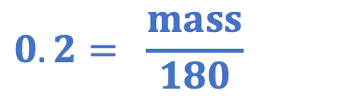
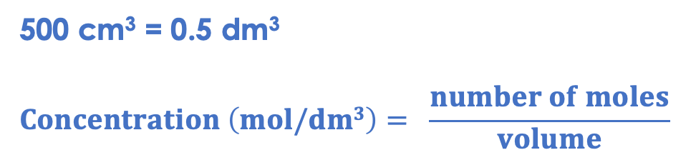
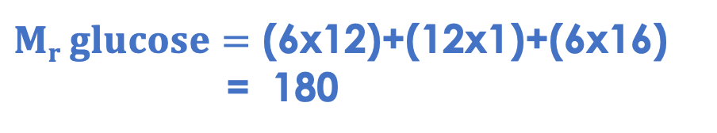
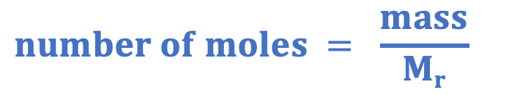
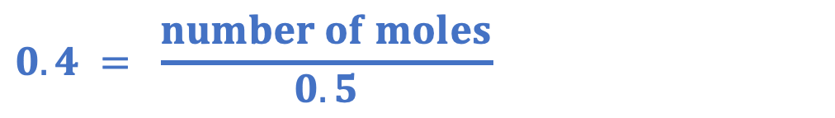

Discuss with your partner how you should solve this question. Work together to find the answer. Some glucose (C₆H₁₂O₆) was dissolved in 500 cm³ of water. The concentration of the solution was 0.4 mol/dm³. What mass of glucose was dissolved in the solution?
$Mr glucose=$ (6x12)+(12x1)+(6x16)
= 180
500 cm³ = 0.5 dm³
$$Concentration \left(mol/dm3\right)= \frac{number of moles}{volume}$$
$$number of moles = \frac{mass}{Mr}$$
$$0.4 = \frac{number of moles}{0.5}$$
$$0.2= \frac{mass}{180}$$
$$number of moles= 0.2$$
$$mass=36 g$$
Notes:
This is provided as a talk task before the I/We/You cycle as a practice for students to identify what information is given and what they might need to work out.
Suggested guidance:
Talk tasks can be used in a variety of ways to suit the particular needs of the students you are teaching. Through exchanging views with others, students develop their understanding of the science beyond what could be achieved individually.
Science classrooms that successfully integrate talk have the following features:
Science talk is a regular feature of lessons and is woven into classroom activities.
Students are paired or grouped strategically by the teacher to ensure productive interaction. This might take into consideration the students’ proficiency of the English language, how encouraging they might be to peers and their attainment in the topic. It’s a good idea to consider these pairings in the class seating plan.
Students are encouraged and supported to talk, but are not forced to talk.
The teacher should take on the role of a facilitator, engaging with conversations where necessary and encouraging or steering the conversation where needed.
Students are encouraged to use the language they have to express their ideas (e.g., everyday language, imperfect English, native language), but also to incorporate science specific terminology where this is more accurate or has been taught.
6. Scientifically inaccurate ideas are not dismissed by the partner or teacher; open discussion and further investigation are relied on to help students construct ideas that support them to progress in their scientific understanding.
7. Guidelines for behaviour during talk tasks are explicit and frequently reviewed. Rules for students might be:
Listen carefully to your partner
Take turns talking.
Speak one at a time, without interrupting.
Politely agree or disagree and explain why.
Politely point out if your partner has used a scientific word incorrectly, if they have explained the science incorrectly, or if there is a more accurate way to describe something.
If confused, ask questions.
Stay focused on the discussion topic.
Respond to one another.

Slide 13


True or false?
True
Concentration can be measured in g/dm³ or mol/dm³
The unit for number of moles is mol
Concentration can be calculated using number of moles x volume
20 cm³ = 0.2 dm³
Relative formula mass is measured in grams
True
False
False
False
Notes:
Purpose: to check that key knowledge from the introduce phase has been learnt and understood.
You may wish to provide students with white boards to enable them to carry out calculations.
1T; 2T; 3F; 4F; 5F;

Slide 14
Drill
State the equation that links concentration, mass and volume.
State the equation that links concentration, number of moles and volume.
State the equation that links number of moles, mass and relative formula mass.
Define relative formula mass.
Calculate the relative formula mass of sodium hydroxide (NaOH).
State the unit for mass.
State the unit for volume.
Convert 50 cm³ to dm³.
State the two units that can be used for concentration.
Notes:
Purpose: This is a knowledge drill. The purpose of this is to check that the critical knowledge is secure before pupils move onto independent practice.
Suggested guidance: There are a range of ways this could be done depending on time and ability range of the class:
Mini whiteboards
As full sentences in exercise books
As short answers in exercise books
In the pupil workbook
As pair talk
As cold call

Slide 15
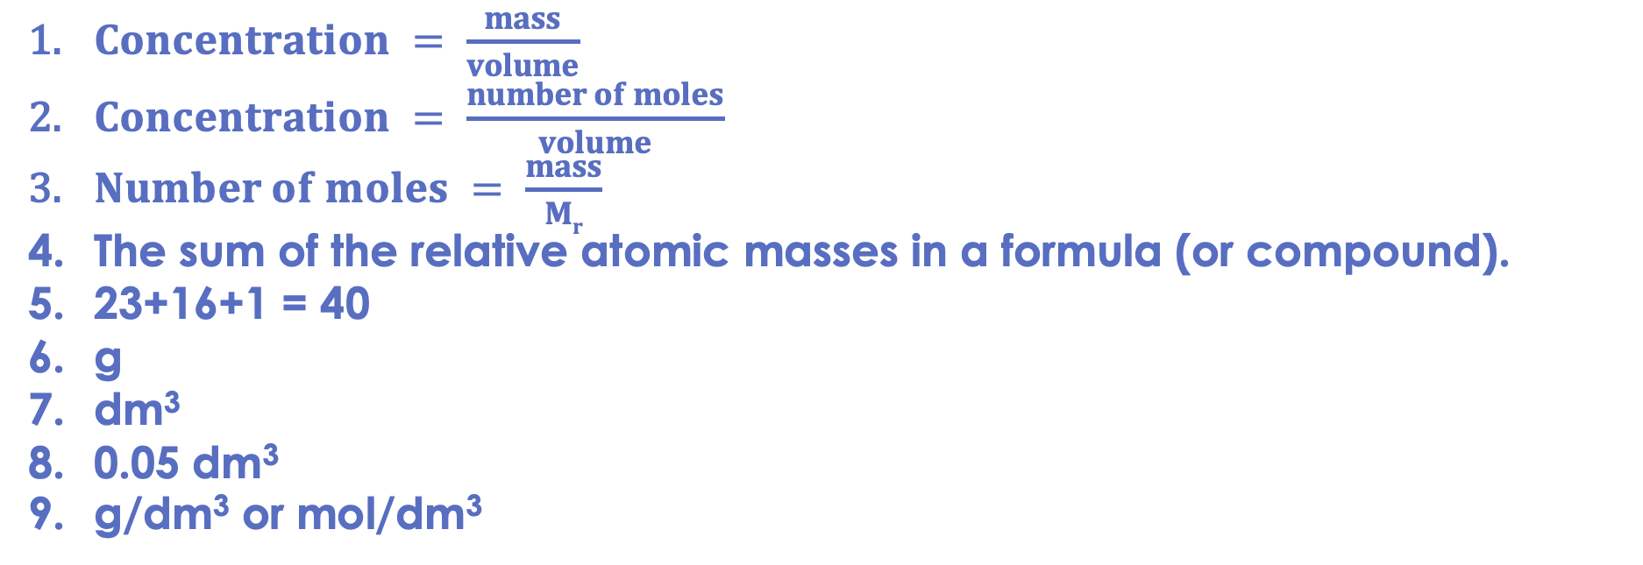
Drill answers
$Concentration = \frac{mass}{volume}$
$Concentration = \frac{number of moles}{volume}$
$Number of moles = \frac{mass}{Mr}$
The sum of the relative atomic masses in a formula (or compound).
23+16+1 = 40
g
dm³
0.05 dm³
g/dm³ or mol/dm³
Notes:
Purpose: This is a knowledge drill. The purpose of this is to check that the critical knowledge is secure before pupils move onto independent practice.
Suggested guidance: There are a range of ways this could be done depending on time and ability range of the class:
Mini whiteboards
As full sentences in exercise books
As short answers in exercise books
In the pupil workbook
As pair talk
As cold call

Slide 16
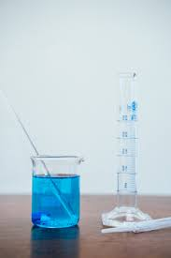
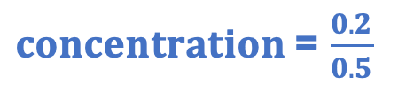
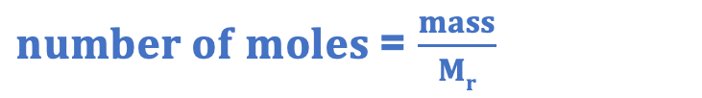

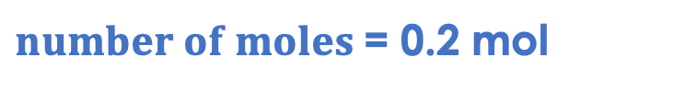
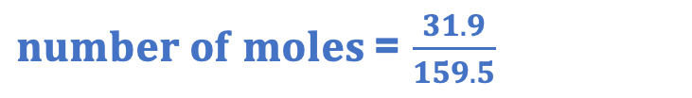

I: Calculating concentration
A scientist makes 500 cm³ of copper sulfate solution by dissolving 31.9 g of copper sulfate (CuSO₄) in water. They want to calculate the concentration of the solution in mol/dm³.
500 cm³ ÷ 1 000 = 0.5 dm³
What is M_{r} of copper sulfate?
63.5 + 32 + (4x16) = 159.5
What is the number of moles in the solution?
$number of moles$= $\frac{mass}{Mr}$
$number of moles$= $\frac{31.9}{159.5}$
$number of moles$= 0.2 mol
What is the concentration of the solution in mol/dm³?
$concentration$= $\frac{number of moles}{volume}$
$concentration$= $\frac{0.2}{0.5}$
$concentration$= 0.4 mol/dm³
Notes:
Purpose: The I-We-You section aims to support pupils to build skills that they most commonly need when answering questions associated with this knowledge in the assessment. This section is also used to interleave other content we expect pupils to know at this stage of their education in order that they build a big picture of the science they are learning.
For the ‘I’ activity, the teacher should model how to answer the question. They can do this by narrating their thinking process aloud, and making links to learning earlier in the lesson explicit.
For the ‘we’ activity, the teacher and students work though a similar example together, in order to prepare students to be able to answer a similar question independently.
Opportunities for the ‘you’ activity – independent practise – occur in the activity portion of the lesson once the student is secure enough to process independently.

Slide 17
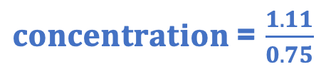
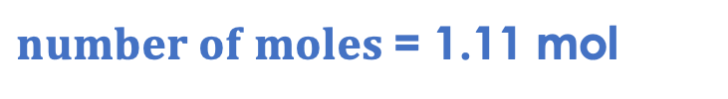
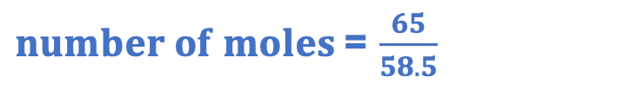

We: Calculating concentration
A student makes 750 cm³ of a solution of sodium chloride by dissolving 65 g of sodium chloride.
750 cm³ ÷ 1 000 = 0.75 dm³
What is M_{r} of sodium chloride?
23 + 35.5 = 58.5
What is the number of moles in the solution?
$number of moles$= $\frac{mass}{Mr}$
$number of moles$= $\frac{65}{58.5}$
$number of moles$= 1.11 mol
What is the concentration of the solution in mol/dm³?
$concentration$= $\frac{number of moles}{volume}$
$concentration$= $\frac{1.11}{0.75}$
$concentration$= 1.48 mol/dm³
Notes:
Purpose: The I-We-You section aims to support pupils to build skills that they most commonly need when answering questions associated with this knowledge in the assessment. This section is also used to interleave other content we expect pupils to know at this stage of their education in order that they build a big picture of the science they are learning.
For the ‘I’ activity, the teacher should model how to answer the question. They can do this by narrating their thinking process aloud, and making links to learning earlier in the lesson explicit.
For the ‘we’ activity, the teacher and students work though a similar example together, in order to prepare students to be able to answer a similar question independently.
Opportunities for the ‘you’ activity – independent practise – occur in the activity portion of the lesson once the student is secure enough to process independently.

Slide 18
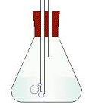
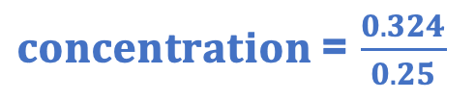

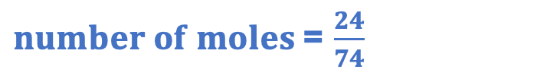

You: Calculating concentration
A scientist makes up 250 cm³ of calcium hydroxide solution by adding 24 g of calcium hydroxide (Ca(OH)₂) to water.
250 cm³ ÷ 1 000 = 0.25 dm³
What is M_{r} of calcium hydroxide?
40 + (2x(16+1)) = 74
What is the number of moles in the solution?
$number of moles$= $\frac{mass}{Mr}$
$number of moles$= $\frac{24}{74}$
$number of moles$= 0.324 mol
What is the concentration of the solution in mol/dm³?
$concentration$= $\frac{number of moles}{volume}$
$concentration$= $\frac{0.324}{0.25}$
$concentration$= 1.30 mol/dm³
Notes:
Purpose: The I-We-You section aims to support pupils to build skills that they most commonly need when answering questions associated with this knowledge in the assessment. This section is also used to interleave other content we expect pupils to know at this stage of their education in order that they build a big picture of the science they are learning.
For the ‘I’ activity, the teacher should model how to answer the question. They can do this by narrating their thinking process aloud, and making links to learning earlier in the lesson explicit.
For the ‘we’ activity, the teacher and students work though a similar example together, in order to prepare students to be able to answer a similar question independently.
Opportunities for the ‘you’ activity – independent practise – occur in the activity portion of the lesson once the student is secure enough to process independently.

Slide 19
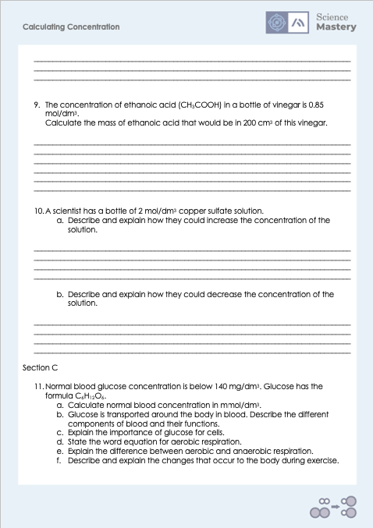
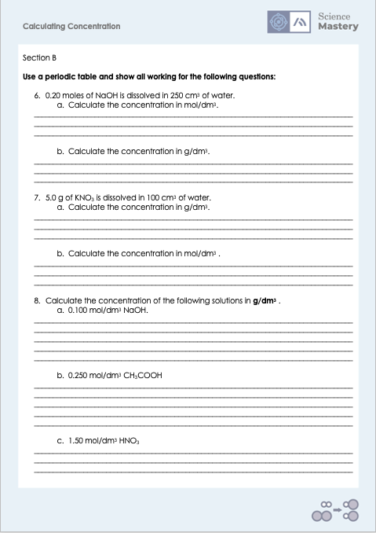
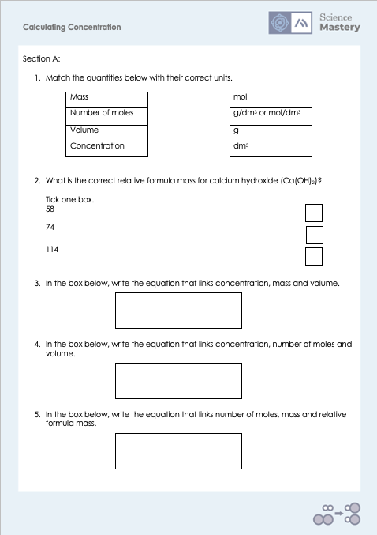
Activity

Slide 20
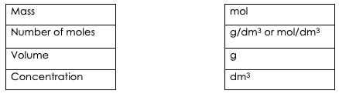
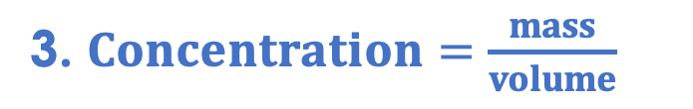


Answers
1.
2. 74
3. $Concentration=\frac{mass}{volume}$
4. $Concentration=\frac{number of moles}{volume}$
5. $Number of moles=\frac{mass}{Mr}$

Slide 21
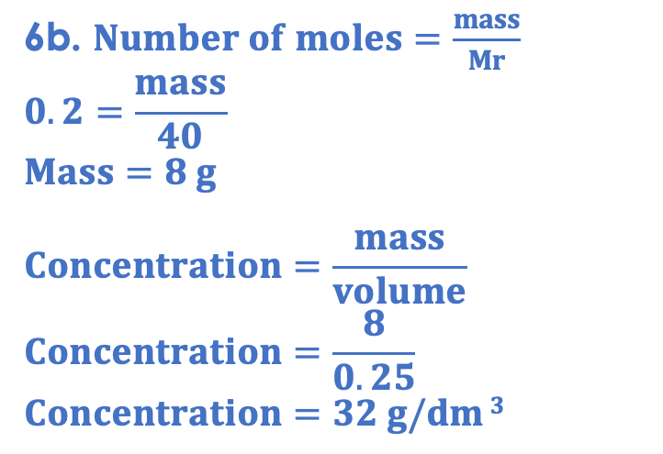
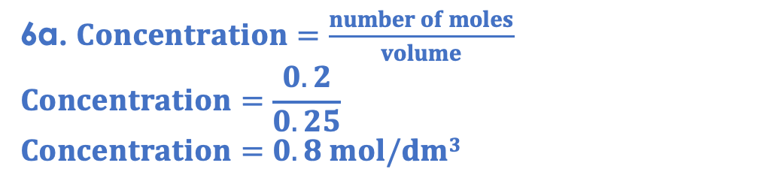
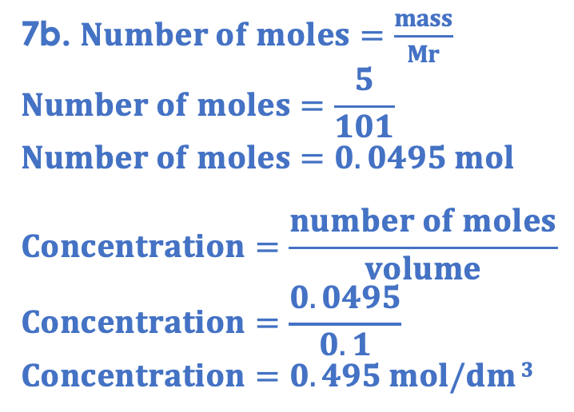
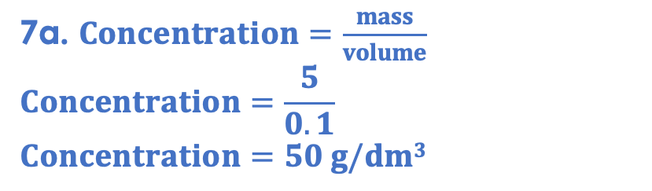
Answers
6a. $Concentration=\frac{number of moles}{volume}$
$$Concentration=\frac{0.2}{0.25}$$
$$Concentration=0.8 mol/dm3$$
7a. $Concentration=\frac{mass}{volume}$
$$Concentration=\frac{5}{0.1}$$
$$Concentration=50 g/dm3$$
6b. $Number of moles=\frac{mass}{Mr}$
$$0.2=\frac{mass}{40}$$
$$Mass=8 g$$
$$Concentration=\frac{mass}{volume}$$
$$Concentration=\frac{8}{0.25}$$
$$Concentration=32 g/dm 3$$
7b. $Number of moles=\frac{mass}{Mr}$
$$Number of moles=\frac{5}{101}$$
$$Number of moles=0.0495 mol$$
$$Concentration=\frac{number of moles}{volume}$$
$$Concentration=\frac{0.0495}{0.1}$$
$$Concentration=0.495 mol/dm 3$$

Slide 22
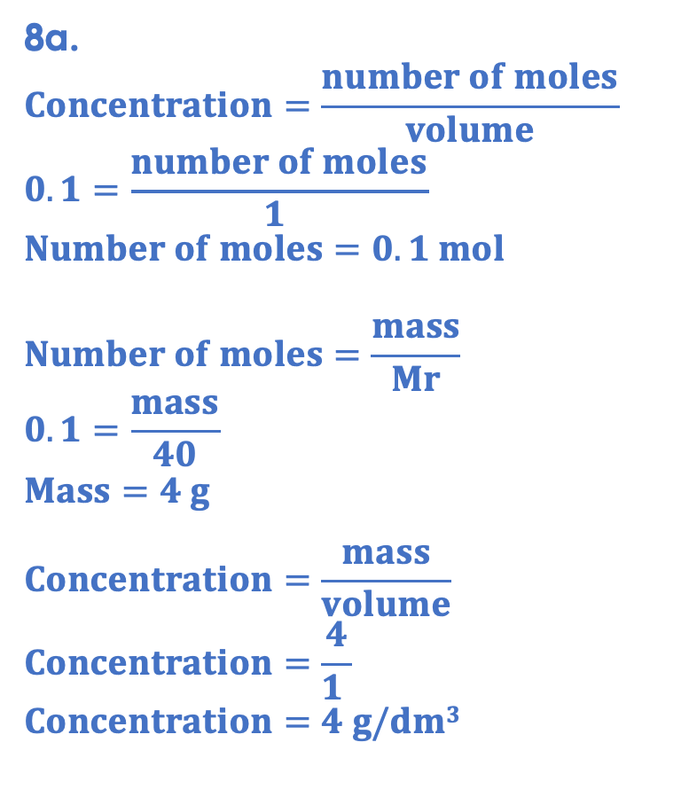
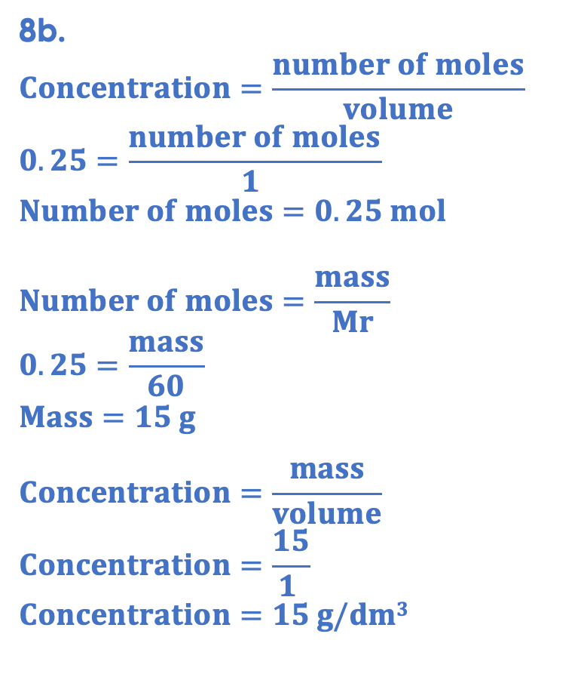
Answers
8a.
$$Concentration=\frac{number of moles}{volume}$$
$$0.1=\frac{number of moles}{1 }$$
$$Number of moles=0.1 mol$$
$$Number of moles=\frac{mass}{Mr}$$
$$0.1=\frac{mass}{40}$$
$$Mass=4 g$$
$$Concentration=\frac{mass}{volume}$$
$$Concentration=\frac{4}{1 }$$
$$Concentration=4 g/dm3$$
8b.
$$Concentration=\frac{number of moles}{volume}$$
$$0.25=\frac{number of moles}{1 }$$
$$Number of moles=0.25 mol$$
$$Number of moles=\frac{mass}{Mr}$$
$$0.25=\frac{mass}{60}$$
$$Mass=15 g$$
$$Concentration=\frac{mass}{volume}$$
$$Concentration=\frac{15}{1 }$$
$$Concentration=15 g/dm3$$
Notes:
For Q8, you may want to show students they can just use 1 dm3 as the volume.

Slide 23
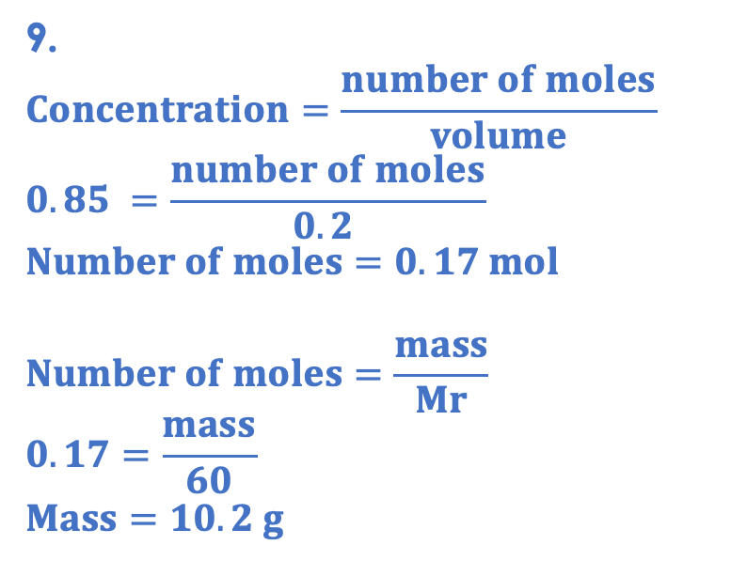
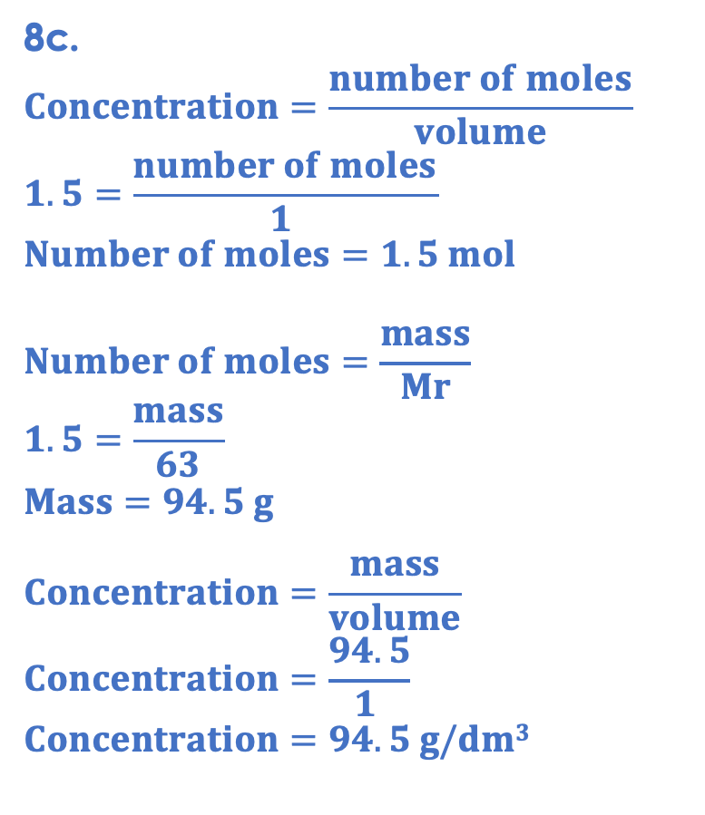
Answers
9.
$$Concentration=\frac{number of moles}{volume}$$
$$0.85 =\frac{number of moles}{0.2 }$$
$$Number of moles=0.17 mol$$
$$Number of moles=\frac{mass}{Mr}$$
$$0.17=\frac{mass}{60}$$
$$Mass=10.2 g$$
8c.
$$Concentration=\frac{number of moles}{volume}$$
$$1.5=\frac{number of moles}{1 }$$
$$Number of moles=1.5 mol$$
$$Number of moles=\frac{mass}{Mr}$$
$$1.5=\frac{mass}{63}$$
$$Mass=94.5 g$$
$$Concentration=\frac{mass}{volume}$$
$$Concentration=\frac{94.5}{1 }$$
$$Concentration=94.5 g/dm3$$
10a. Adding more solute so there is a greater mass of solute per unit volume, or removing some solvent (by evaporation or distillation) so the same mass of solute is present in a smaller given volume.
10b. Adding more solvent so there is a small mass of solute per unit volume, or removing some solute (by distillation, so solvent is collected separately) so a smaller mass of solute is present in the given volume.

Slide 24
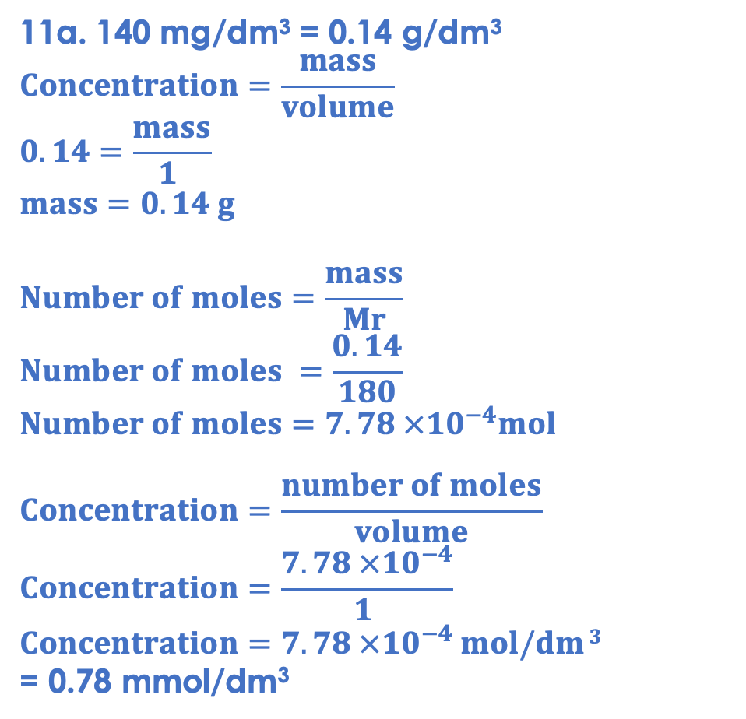
Answers
11a. 140 mg/dm³ = 0.14 g/dm³
$$Concentration=\frac{mass}{volume}$$
$$0.14=\frac{mass}{1 }$$
$$mass=0.14 g$$
$$Number of moles=\frac{mass}{Mr}$$
$$Number of moles =\frac{0.14}{180}$$
$$Number of moles=7.78 ×{10}^{−4}mol$$
$$Concentration=\frac{number of moles}{volume}$$
$$Concentration=\frac{7.78 ×{10}^{−4}}{1 }$$
$$Concentration=7.78 ×{10}^{−4} mol/dm 3$$
= 0.78 mmol/dm³

Slide 25
Answers
11b.
Red blood cells: carry oxygen
White blood cells: protect against infection
Platelets: help blood to clot
Plasma: carries components and dissolved substances
11c. Glucose is a reactant for respiration, without which cells would not be able to release energy.
11d. Glucose + oxygen → carbon dioxide + water
11e.
Aerobic respiration is in the presence of oxygen but anaerobic respiration is in the absence of oxygen.
Aerobic respiration releases much more energy than anaerobic respiration.
Both use glucose as a reactant, but anaerobic respiration also uses oxygen.
Aerobic respiration produces carbon dioxide and water but anaerobic respiration produces lactic acid in animals and carbon dioxide and ethanol in plants and yeast.

Slide 26
Answers
11f.
During exercise:
Pulse/heart rate increases: so that blood is pumped around the body faster, delivering oxygen and glucose to cells for a greater rate of respiration
Breathing rate and volume increase: so that more oxygen is taken into the body, for a greater rate of respiration
When cells cannot get enough oxygen, they begin to respire anaerobically, which produces lactic acid and leads to muscle fatigue

Slide 27
Answer the questions below.
Calculate the concentration of a 750 cm³ solution that contains 1.5 mol of solute.
A. 1.5 mol/dm³
B. 0.02 g/dm³
C. 2 mol/dm³
✓
Calculate the number of moles in 2 dm³ of 0.5 mol/dm³ solution.
A. 4 mol
B. 1 mol
C. 0.25 mol
✓
80 g of sodium hydroxide (M_{r} = 40) is dissolved in solution. How many moles of solute are in the solution?
A. 2 mol
B. 0.5 mol
C. 3200 mol
✓
Notes:
Q1. Answer: C
If students answer A, it suggests they are not clear on the different units for concentration. If students answer B, they have used the correct calculation but have not converted to dm3. To fix it, give students more practice of identifying values given from written questions.
Q2. Answer: B
If students answer A, they have divided volume by concentration. If students answer C, they have divided concentration by volume. To fix it, remind the student of the correct formula to calculate concentration. Model the method to work this calculation out, and then give the student some similar calculations to try.
Q3. Answer: A
If students answer B, they have divided Mr by mass. If students answer C, they have multiplied mass by Mr. To fix it, give students more calculation practice, using mixed questions where students are solving between different unknowns for the different concentration equations and the mass/Mr equation.

Slide 28
Lesson C4.3.5
What was good about this lesson? | What can we do to improve this lesson?
Send us your feedback by clicking this link
or by emailing sciencemastery@arkonline.org
Thank you!

